Slide 1
Skills in Utility Management
October 2021

Slide 2
Facilities Management - Energy and Water Monitoring
What is Energy and Water Monitoring?
Key Questions
Hardware Requirements to Enable Monitoring
Energy Management
Water Management
Monitoring Platform
Copper
Aqua
Field Support Skills
Case Studies

Slide 3
Energy and Water Monitoring
The Key Questions
Are you managing your energy and water effectively?
Are you being billed correctly and on the best tariff?
Do you know where you are utilizing energy and water?
Do you know what energy and water management opportunities exist?
With systems like our Energy Monitoring and Water Monitoring Software, you are able to take control of your Energy and Water Costs and start saving immediately

Slide 4
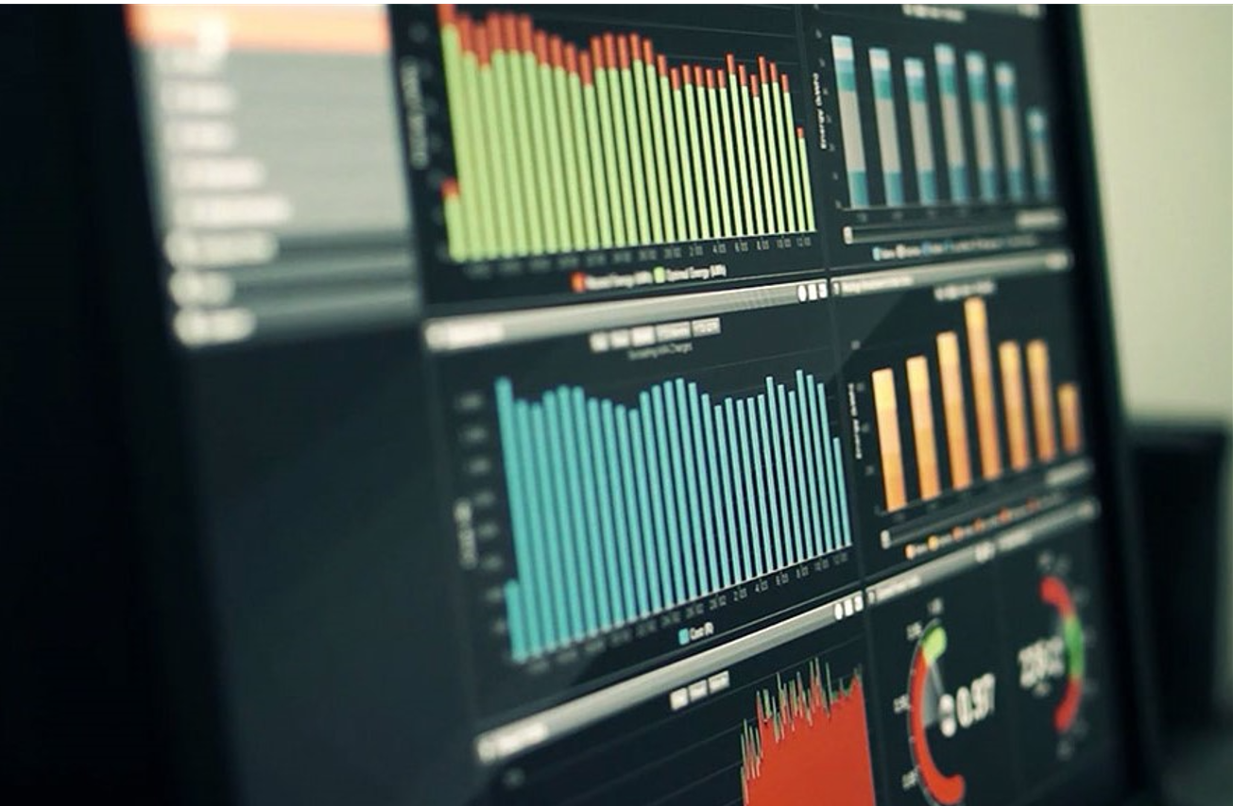
Energy Monitoring Hardware Requirements
Smart Meters (MV and LV)
Communications device (modem, ethernet network etc.) via Internet
Database
Web based front end
Dashboard for simple,
immediate understanding

Slide 5
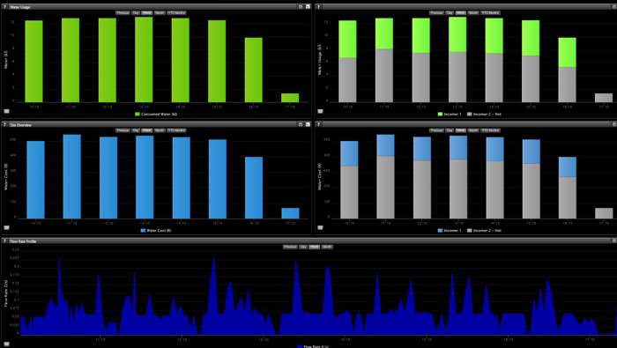
Water Monitoring Hardware Requirements
Smart Water Meters
Communications device (Sensus Wifi +3G, Sigfox, Lora, ) via Internet
Database
Web based front end
Dashboard for simple,
immediate understanding

Slide 6
Terra Firma Solutions Energy and Water Monitoring Platform
Anomalies
Trends
Peak Demand
Time of Use
Analyse and Evaluate Municipal Tariffs
Identify where you are Over or Under billed
Billing
Bill tenants easily and accurately
Fully automated reporting

Slide 7
Smart Metering Field Support Skills - Energy
Installation
Qualified Installation Electricians
Experienced in Smart Metering
Accuracy of Installation Essential:
Single Line Diagrams
Location of Smart Meter
Programming of Smart Meter
Communications Verification
Data Validation
Maintenance
Qualified Electricians to support
Loss of Communication – meter offline
Loss of Power – meter offline
Load Profile – incorrect
Very rare that we experience meter failure

Slide 8
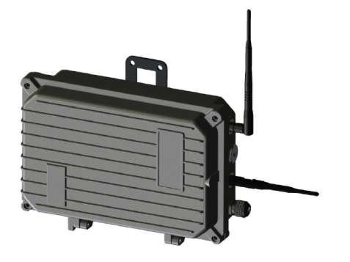
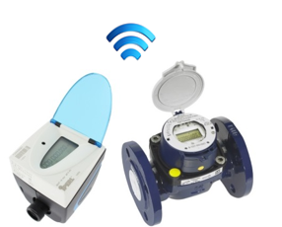
Smart Metering Field Support Skills - Water
Installation
Qualified Installation Plumbers / Technicians
Experienced in Smart Metering
Accuracy of Installation Essential:
Location of Smart Meter
Programming of Smart Meter
Communications Verification
Data Validation
Maintenance
Qualified Plumbers / Technicians to support
Loss of Communication – meter offline
Constant Zero – no flow
Flow Profile – incorrect, reverse flow, multipliers

Slide 9
Smart Electricity Metering Case Studies
Case Studies
Residence
Main Electrical Incomer not equal to the sum of all the sub electrical meters at the facility
Sub meter examples:
Kitchens, Heat Pumps and Bathrooms
Additional supplies not accounted for
Meters may be incorrectly programmed
Breakers labelled incorrectly
Single Line Diagrams outdated
Success Stories
Tracking of all Residences electrical consumption
Monitoring of night and vacation loads
Apply energy efficient interventions:
LED Lighting
Change in human behaviour
Heat Pumps

Slide 10
Smart Water Metering Case Studies
Case Studies
University Residences
Establish current consumptions at SU residences
Identify poor behaviour, anomalies and trends
Main water incomer(meter) not equal to the sum of all the sub water meters at the facility
Sub water meter examples:
Kitchens, Heat Pumps and Bathrooms
Success Stories
Tracking of burst pipes through alerts
Response time reduce, limited wastage
Monitoring of night and vacation consumption
Greater understanding of water use
Influence change in behaviour
Sharing of information to all

Slide 11
Thank You

